Slide 1

Fundamentals of Testing
Basic Concepts
Software Quality Assurance
Telerik Software Academy
http://academy.telerik.com

Slide 2
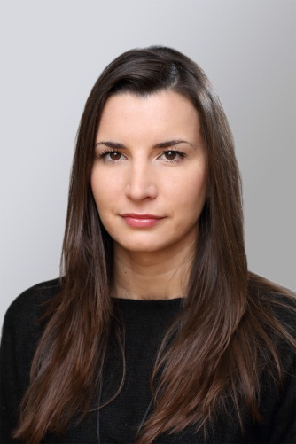
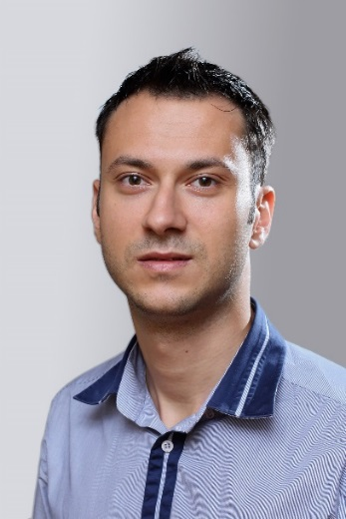
The Lectors
Snejina Lazarova
Project Manager
BI & Reporting Team
Dimo Mitev
QA Architect
Backend Services Team

Slide 3

Table of Contents
Why is Testing Necessary?
Software Systems Context
Causes of Software Defects
Role of Testing in Software Development, Maintenance and Operations
Testing and Quality
How Much Testing is Enough?
What is Testing?
Seven Testing Principles

Slide 4

Why is Testing Necessary?

Slide 5



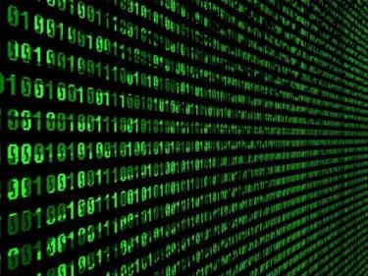
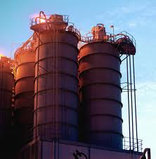


Software Systems Context
Software systems are integral part of every sphere of our life
Education
Industry
Business
Industry
Military
Entertainment

Slide 6

Causes of Software Defects
A human being can make an error (mistake)
Errors produce defects
Defects are faults / bugs in the program code, or in a document
If a defect in code is executed, that might cause a failure:
Fail to do what it should do
Do something it shouldn’t

Slide 7
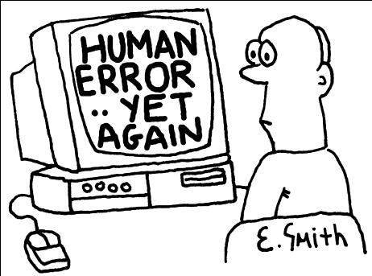

Causes of Software Defects (2)
The human factor
Humans make mistakes
Poor training
Time pressure
Code complexity
Complexity of infrastructure
Changing technologies

Slide 8
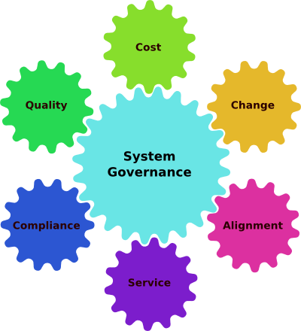
Causes of Software Defects (3)
Organizational factors
Inefficient communication
Unclearly defined requirements
Environmental conditions
Radiation, Magnetism, Electronic fields, Pollution, Etc.
These can change the hardware conditions

Slide 9
Definitions
Anomaly
Any condition that deviates from expectation based on requirements specifications, design documents, user documents, standards, etc. or from someone’s perception or experience
Error (mistake)
A human action that produces an incorrect result

Slide 10
Definitions (2)
Bug/Defect/Fault/Problem
A flaw in a component or system that can cause the component or system to fail to perform its required function
A defect, if encountered during execution, may cause a failure of the component or system.
Failure
Actual deviation of the component or system from its expected delivery, service or result
Defect/fault masking
An occurrence in which one defect prevents the detection of another

Slide 11

What is Software Quality?
Definition found in IEEE Standard Glossary Of Software Engineering Terminology
The degree to which a system, component, or process meets specified requirements
The degree to which a system, component, or process meets customer or user needs or expectations

Slide 12
The Role of Testing
Role of testing in software development, maintenance and operations
Reduce the risk of problems
Reduce long-term defect-related costs
Contribute to the quality of the software
Help meeting standards:
Contractual or legal requirements
Industry-specific standards

Slide 13

Testing and Quality
Testing can give confidence in the quality of the software if it finds few or no defects
If defects are found, the quality increases when those defects are fixed
Lessons learnt from previous mistakes improve future performance

Slide 14
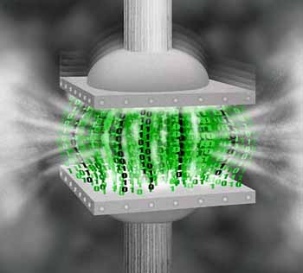
How Much Testing is Enough?
How much testing should be done is a matter of risk:
Too much testing can delay the product release and increase the product price
Insufficient testing hides risks of errors in the final product

Slide 15

What Is Testing?

Slide 16
What is Testing?
What is testing?
The process of exercising software
To verify that it satisfies specified requirements and to detect errors
The process of analyzing a software item
To detect the differences between existing and required conditions (that is, bugs),
To evaluate the features of the software item
Notes:
http://www.aptest.com/glossary.html

Slide 17

What is Testing?
What is testing?
The process of operating a system or component under specified conditions
Observing or recording the results
Making an evaluation of some aspect of the system or component
Notes:
http://www.aptest.com/glossary.html

Slide 18

Main Test Activities
Testing is not just running tests, but also:
Planning and control
Choosing test conditions
Designing and executing test cases
Checking results
Evaluating exit criteria
Reporting on the testing process and system under test
Finalizing or completing closure activities

Slide 19

Main Objectives in Testing
Testing pursues several objectives:
Finding defects
Gaining confidence about the level of quality
Providing information for decision-making
Preventing defects

Slide 20
Different Viewpoints
Objectives of testing differ according to the point of view:
Developers
Are perceived as very creative - they write code without which there would be no system
Are rarely good communicators
Can often specialize in just one or two skills (e.g. VB, C++, JAVA, SQL)
Notes:
Positive Testing: Operate application or software as it should be operated. Use proper variety of test data, including data values at boundries to test if it fails. Check actual test results with the expected and see
- Does it behave normally? - Are results correct? - Does the software function correctly?
Negative Testing: Test for abnormal operations. Test with illegal / abnormal test data. Intentionally attempt to make things go wrong and to discover / detect and see
- Does the system fail / crash? - Does the program do what it should not? - Does it fail to do what it should?

Slide 21
Different Viewpoints
Objectives of testing differ according to the point of view:
QA testers
Are perceived as destructive - only happy when they are finding faults!
Usually require good communication skills, tact & diplomacy.
Normally need to be multi-talented (technical, testing, team skills).

Slide 22
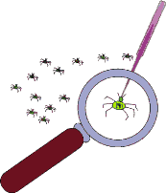

Debugging VS Testing
Testing
The activity that initially finds failures in a software item
Debugging
The development activity that finds, analyses and removes the cause of the failure
Subsequent re-testing by a tester
Ensures that the fix does indeed resolve the failure

Slide 23

Seven Testing Principles

Slide 24

Seven Testing Principles
Testing shows presence of defects
Testing can show that defects are present
Cannot prove that there are no defects
Appropriate testing reduces the probability for defects

Slide 25

Seven Testing Principles (2)
Exhaustive testing is impossible
All combinations of inputs and preconditions are usually almost infinite number
Testing everything is not feasible
Except for trivial cases
Risk analysis and priorities should be used to focus testing efforts

Slide 26
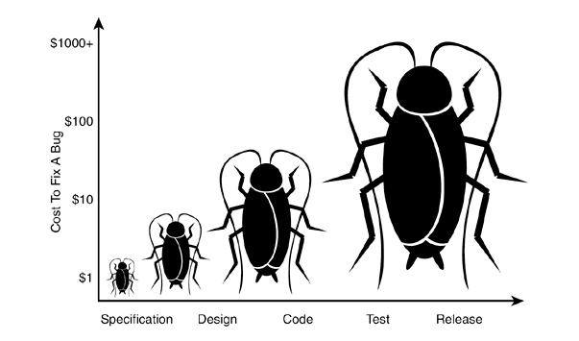
Seven Testing Principles (3)
Early testing
Testing activities shall be started as early as possible
And shall be focused on defined objectives
The later a bug is found – the more it costs!

Slide 27
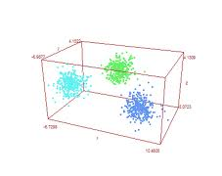
Seven Testing Principles (4)
Defect clustering
Testing effort shall be focused proportionally
To the expected and later observed defect density of modules
A small number of modules usually contains most of the defects discovered
Responsible for most of the operational failures
Notes:
In your opinion which operation is most likely to cause your Operation system to fail?
- Opening Microsoft Word
- Open IE
- Opening 10 different application all at the same time

Slide 28

Seven Testing Principles (5)
Pesticide paradox
Same tests repeated over and over again tend to loose their effectiveness
Previously undetected defects remain undiscovered
New and modified test cases should be developed

Slide 29
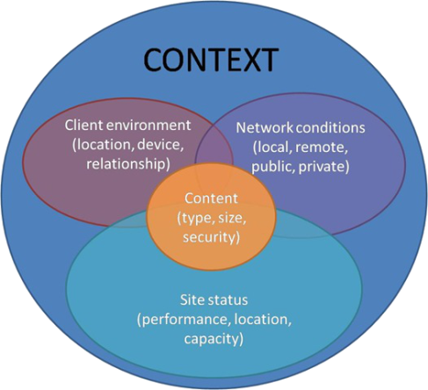
Seven Testing Principles (6)
Testing is context dependent
Testing is done differently in different contexts
Example: safety-critical software is tested differently from an e-commerce site

Slide 30
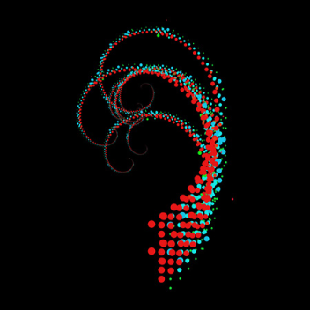
Seven Testing Principles (7)
Absence-of-errors fallacy
Finding and fixing defects itself does not help in these cases:
The system built is unusable
Does not fulfill the users’ needs and expectations

Slide 31
Fundamentals of Testing
?
?
?
?
?
Questions?
?
?
?
?
?
?

Slide 32
Exercises
A test team consistently finds between 90% and 95% of the defects present in the system under test. While the test manager understands that this is a good defect-detection percentage for her test team and industry, senior management and executives remain disappointed in the test group, saying that the test team misses too many bugs. The users are generally happy with the system and the failures which have occurred have generally been low impact.
Continues …

Slide 33
Exercises (2)
Which of the following testing principles is most likely to help the test manager explain to these managers and executives why some defects are likely to be missed?
Exhaustive testing is impossible
Defect clustering
Pesticide paradox
Absence-of-errors fallacy

Slide 34
Exercises (3)
Find in the Internet information about the ISTQB (International Software Testing Board): http://istqb.org
Search the Internet and get familiar with some famous examples of software failures and the costs that have occurred from them
E.g., you can find some information here: http://www.devtopics.com/20-famous-software-disasters/
Reproduce the following bugs in windows 7:
http://www.askvg.com/microsoft-windows-seven-bug-report/

Slide 35




Free Trainings @ Telerik Academy
C# Programming @ Telerik Academy
csharpfundamentals.telerik.com
Telerik Software Academy
academy.telerik.com
Telerik Academy @ Facebook
facebook.com/TelerikAcademy
Telerik Software Academy Forums
forums.academy.telerik.com

